Slide 1

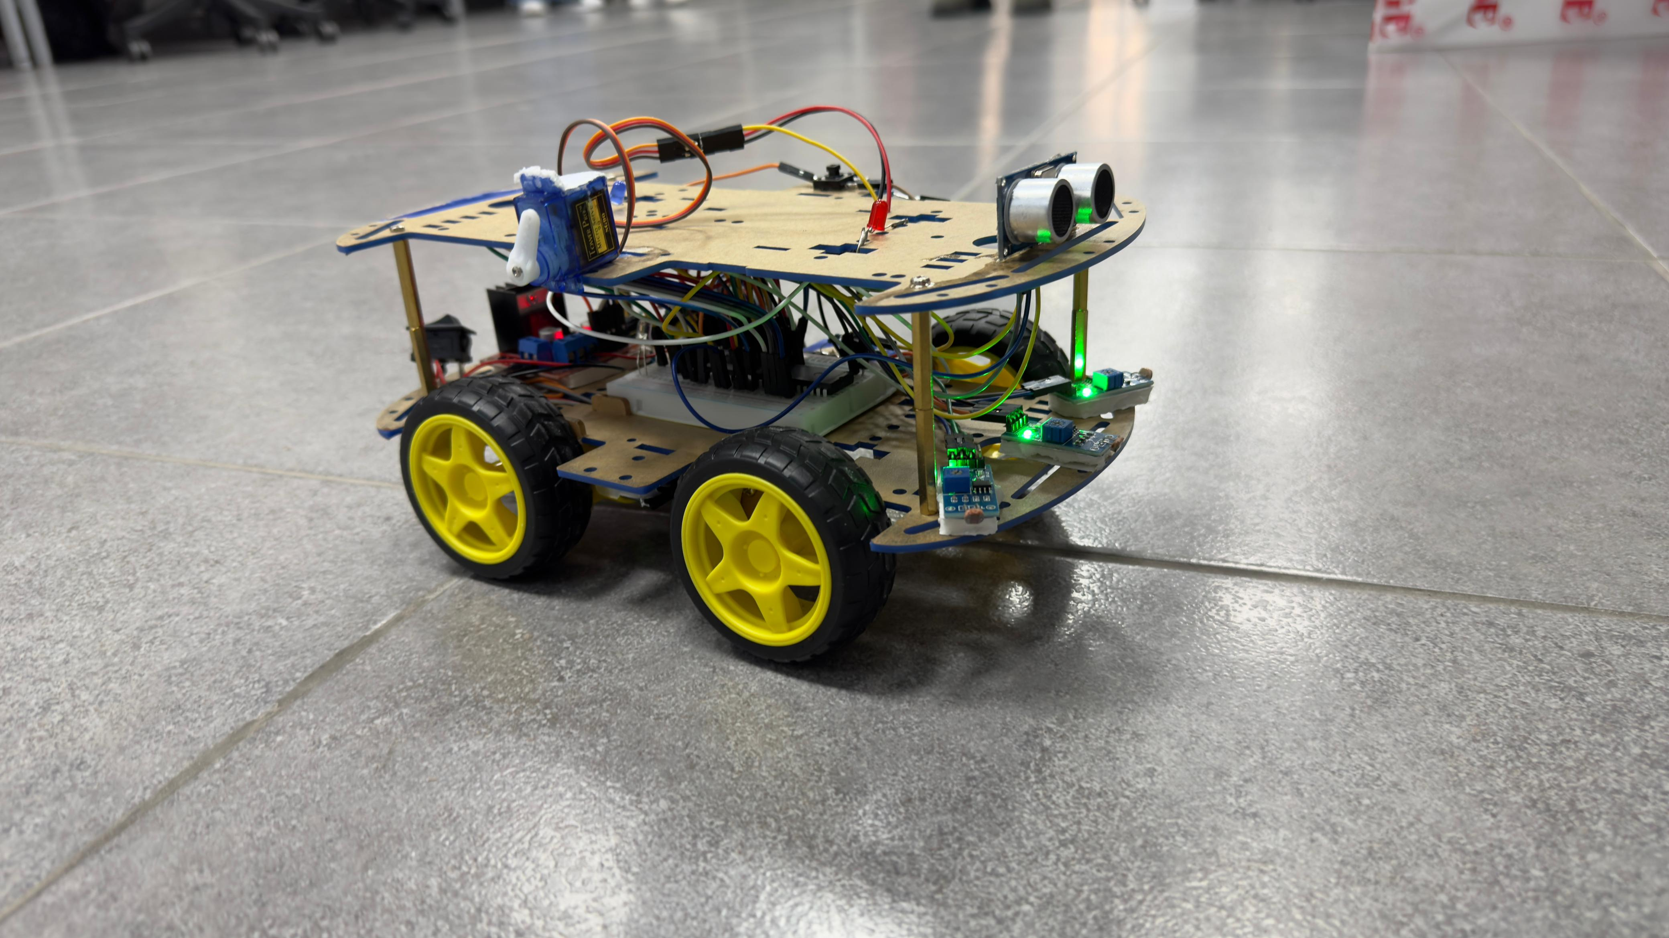
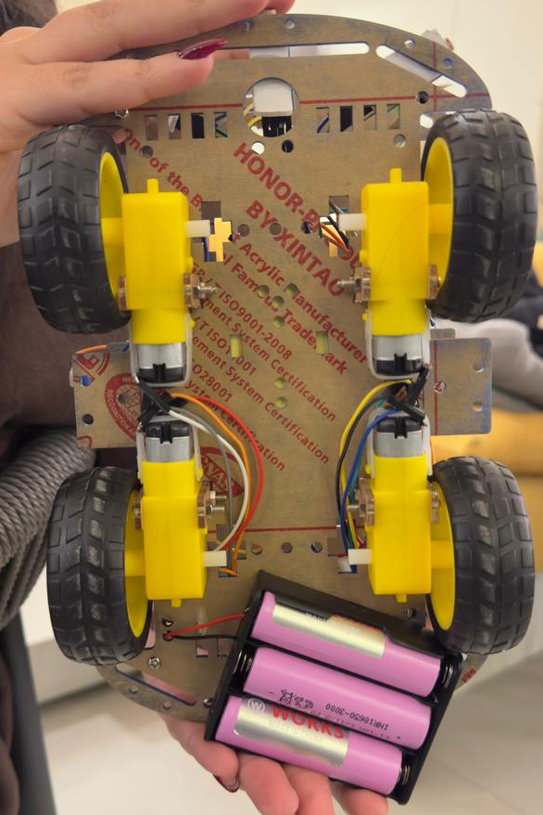
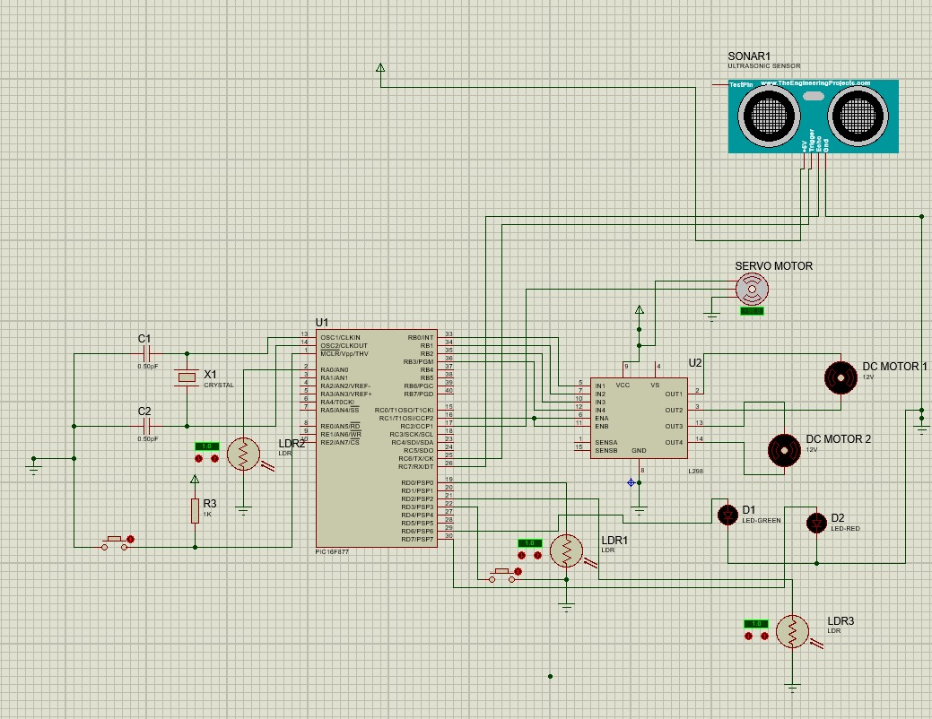
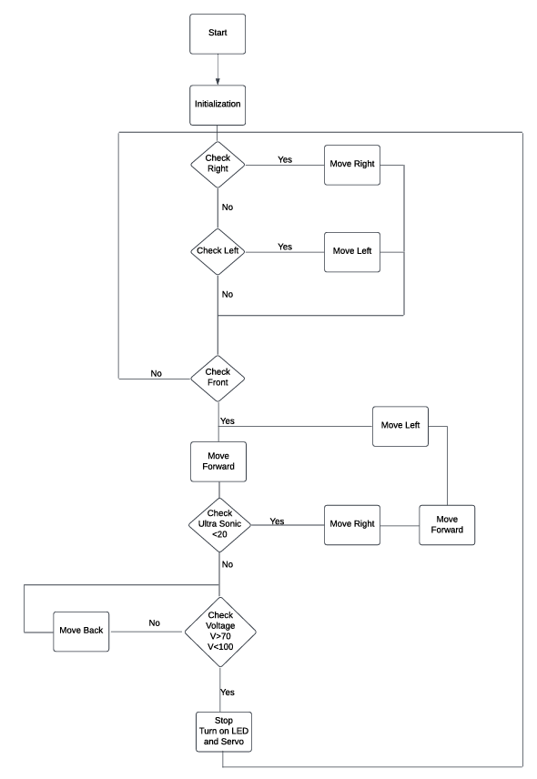
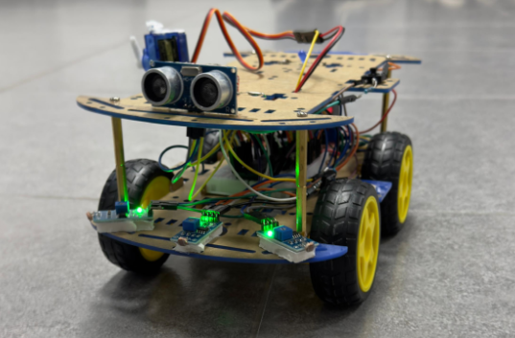
Light-Following Robotic Car
J. Tutanji, R. Alamer and M. Rowad
Supervisor: Dr. Esam Qaralleh Dr. Belal H. Sababha
Embedded Systems Final Design Project, Fall 2024/2025
King Abdullah II School of Engineering
Princess Sumaya University for Technology
Introduction
The light-following robotic car is a system designed for autonomous navigation and obstacle avoidance. Utilizing LDR light sensors, the car tracks and moves toward a light source while ensuring safe operation through an ultrasonic sensor that detects obstacles in its path. The car halts upon detecting an obstacle and intelligently navigates around it by executing predefined right and left movements. By integrating a PIC16F877A microcontroller with servo motors, an H-Bridge motor driver, and a robust power supply system, this project highlights the practical applications of embedded systems in autonomous vehicles and automation.
Results
The car’s behavior was precise and consistent, with seamless integration between the electrical components, software logic, and mechanical design. The use of LDR sensors for light detection and an ultrasonic sensor for obstacle avoidance ensured high reliability and responsiveness.
Design
The project aims to develop an autonomous car capable of detecting and following a light source while avoiding obstacles in its path. This is achieved by integrating light-dependent resistors (LDRs) to detect light intensity and ultrasonic sensors to measure distances from nearby obstacles. A microcontroller processes the input data and sends signals to the motors to adjust the car’s movement accordingly.
Figure 3: Side View.
Figure 1: Electrical Schematics of the ports connected with the PIC16F877A.
Figure 4: DC Motors Back View.
Figure 2: Flow Chart.
Figure 5:Front View .
Conclusion
The light-following car with obstacle avoidance demonstrates the practical application of embedded systems in autonomous navigation. By integrating LDR sensors, an ultrasonic sensor, and a PIC16F877A microcontroller, the project achieves a cost-effective yet efficient design capable of real-time decision-making. This project serves as a stepping stone for more advanced systems, showcasing how sensor fusion and programming can solve real-world challenges. It has potential applications in robotics, automation, and smart mobility solutions, providing a foundation for future exploration in autonomous vehicle technologies. The success of this project highlights the importance of interdisciplinary collaboration between hardware, software, and mechanical design, proving that embedded systems are a cornerstone for innovation in modern engineering.

